Slide 1
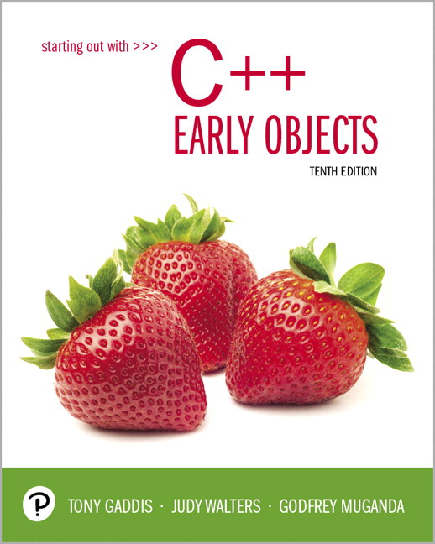
Starting Out with C++ Early Objects
Tenth Edition
Chapter 9
Searching, Sorting, and Algorithm Analysis

Slide 2
Topics
9.1 Introduction to Search Algorithms
9.2 Searching an Array of Objects
9.3 Introduction to Sorting Algorithms
9.4 Sorting an Array of Objects
9.5 Sorting and Searching Vectors
9.6 Introduction to Analysis of Algorithms

Slide 3
9.1 Introduction to Search Algorithms
Search: to locate a specific item in a list (array, vector, etc.) of information
Two algorithms (methods) considered here:
Linear search (also called sequential search)
Binary search

Slide 4
Linear Search Algorithm
Set found to false
Set position to –1
Set index to 0
While index < number of elts and found is false
If list [index] is equal to search value
found = true
position = index
End If
Add 1 to index
End While
Return position

Slide 5
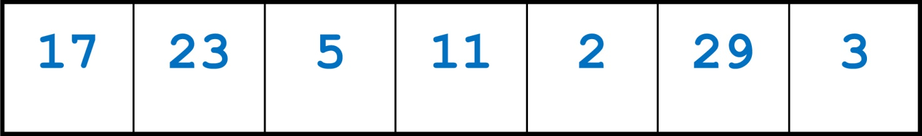
Linear Search Example
Array numlist contains
Searching for the value 11, linear search examines 17, 23, 5, and 11
Searching for the value 7, linear
search examines 17, 23, 5, 11, 2, 29, and 3
Notes:
See pr9-01.cpp

Slide 6
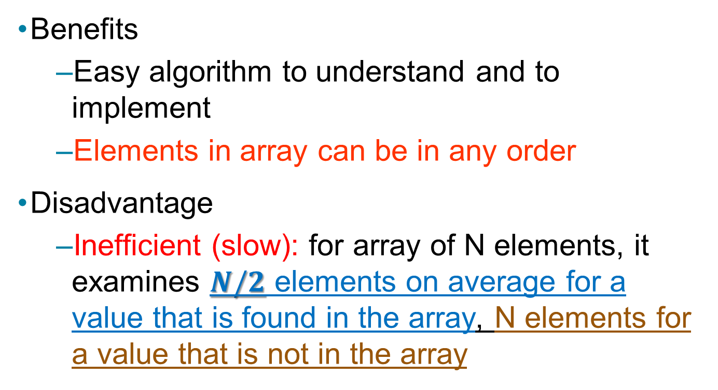
Linear Search Tradeoffs
Benefits
Easy algorithm to understand and to implement
Elements in array can be in any order
Disadvantage
Inefficient (slow): for array of N elements, it examines $N/2$ elements on average for a value that is found in the array, N elements for a value that is not in the array

Slide 7
Binary Search Algorithm
Binary search requires that the array is in order.
Examine the value of the middle element
If the middle element has the desired value, done. Otherwise, determine which half of the array may have the desired value. Continue working with this portion of the array.
Repeat steps 1 and 2 until either the element with the desired value is found or there are no more elements to examine.

Slide 8
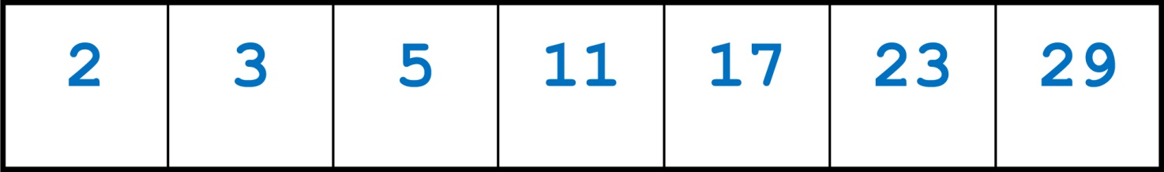
Binary Search Example
Array numlist2 contains
Searching for the value 11, binary search examines 11 and stops
Searching for the value 7, binary
search examines 11, 3, 5, then stops
Notes:
See pr9-02.cpp

Slide 9
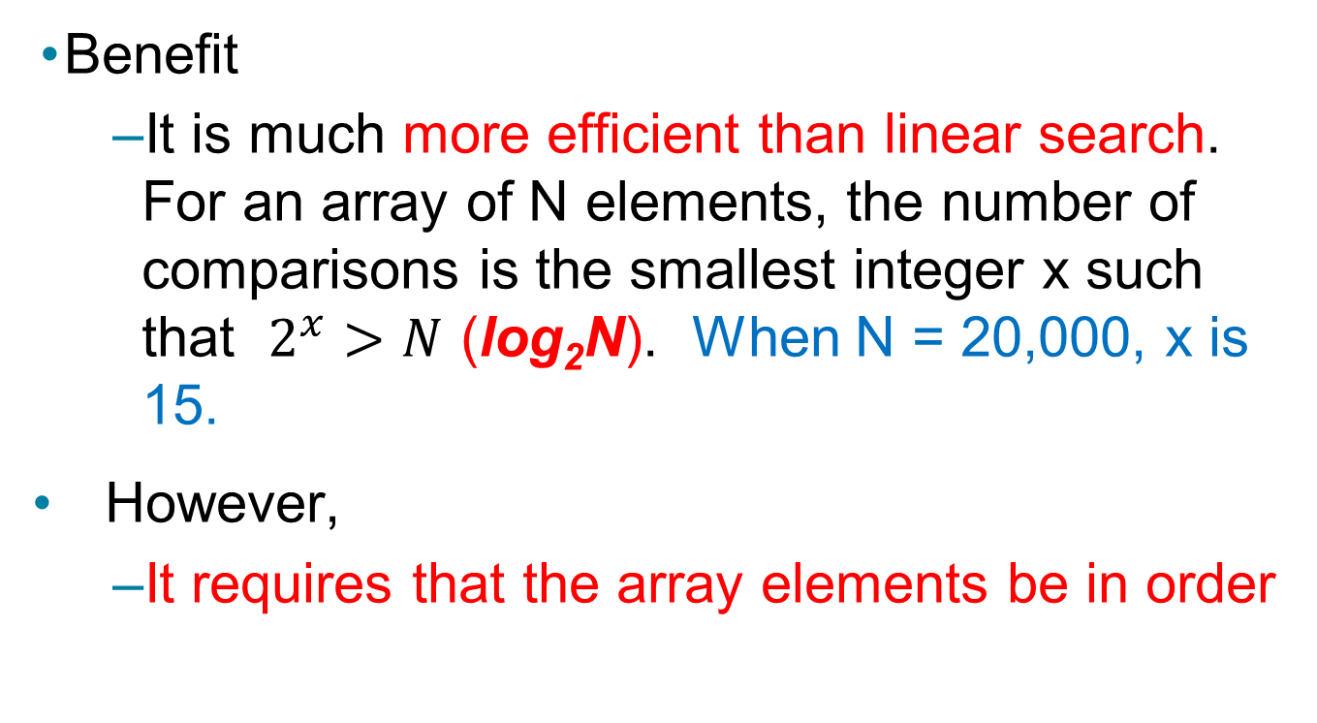
Binary Search Tradeoffs
Benefit
It is much more efficient than linear search. For an array of N elements, the number of comparisons is the smallest integer x such that $2^{x}>N$ (log₂N). When N = 20,000, x is 15.
However,
It requires that the array elements be in order

Slide 10
9.2 Searching an Array of Objects
Search algorithms are not limited to arrays of integers
When searching an array of objects or structures, the value being searched for is a member of an object or structure, not the entire object or structure
Member in object/structure: key field
Value used in search: search key
Notes:
See pr9-03.cpp

Slide 11
9.3 Introduction to Sorting Algorithms
Sort: arrange values into an order
Alphabetical
Ascending (smallest to largest) numeric
Descending (largest to smallest) numeric
Two algorithms considered here
Bubble sort
Selection sort
Insertion sort

Slide 12
Bubble Sort Algorithm
Compare 1st two elements and exchange them if they are out of order.
Move down one element and compare 2nd and 3rd elements. Exchange if necessary. Continue until the end of the array.
Pass through the array again, repeating the process and exchanging as necessary.
Repeat until a pass is made with no exchanges.
Notes:
See pr9-04.cpp

Slide 13
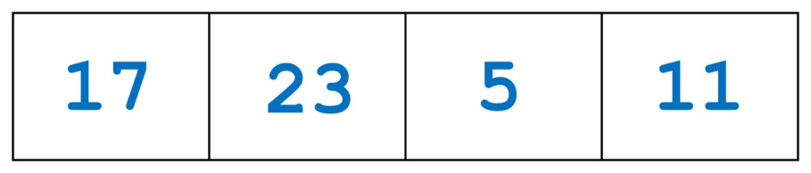
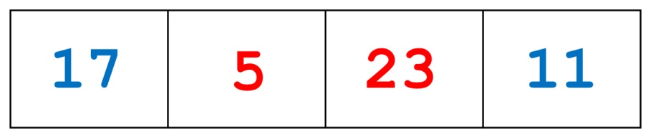
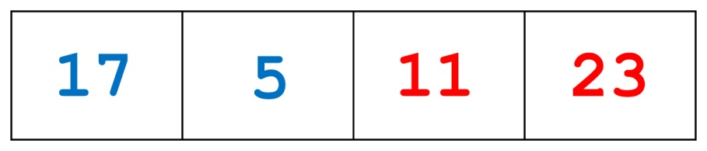
Bubble Sort Example 1 of 3
Array numlist3 contains
Compare values 17 and 23. They are in order, so no exchange is needed.
Compare values 23 and 5. Exchange them.
Compare values 23 and 11. Exchange them.
This is the end of the first pass of sorting using Bubble Sort.

Slide 14
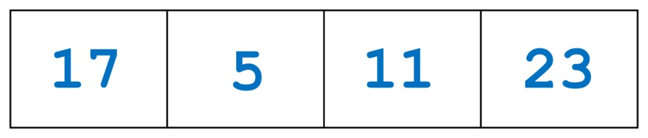
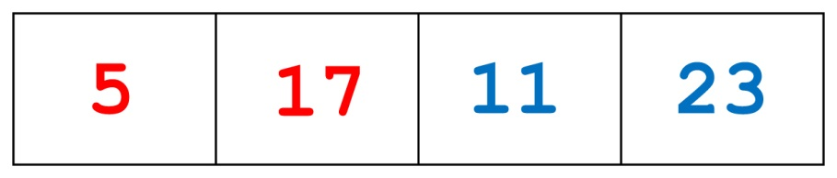
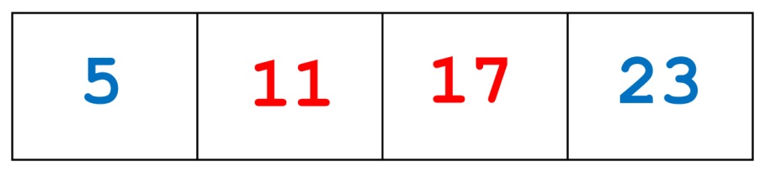
Bubble Sort Example 2 of 3
The second pass starts with the array from pass one
Compare values 17 and 5. Exchange them.
Compare 17 and 11. Exchange them.
Compare 17 and 23. No exchange is needed.
This is the end of the second pass.

Slide 15
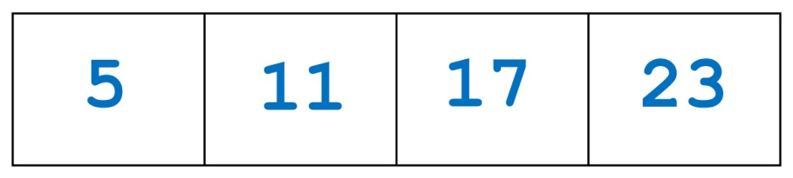
Bubble Sort Example 3 of 3
The third pass starts with the array from pass two
Compare values 5 and 11. No exchange is needed.
Compare values 11 and 17. No exchange is needed.
Compare values 17 and 23. No exchange is needed.
Since no exchanges were made, the array is in order.

Slide 16
Bubble Sort Tradeoffs
Benefit
It is easy to understand and to implement
Disadvantage
It is inefficient due to the number of exchanges. This makes it slow for large arrays

Slide 17
An Improved Bubble Sort
If no exchanges occur in a pass using Bubble Sort, then the array must already be in order.
This can be incorporated into the Bubble Sort algorithm:
detect if an exchange was made in the inner for loop and set a boolean flag.
test the flag in the outer for loop and terminate execution if no exchanges were made.

Slide 18
Selection Sort Algorithm
Locate the smallest element in the array and exchange it with the element in position 0.
Locate the next smallest element in the array and exchange it with element in position 1.
Continue until all of the elements are in order.
Notes:
See pr9-05.cpp

Slide 19
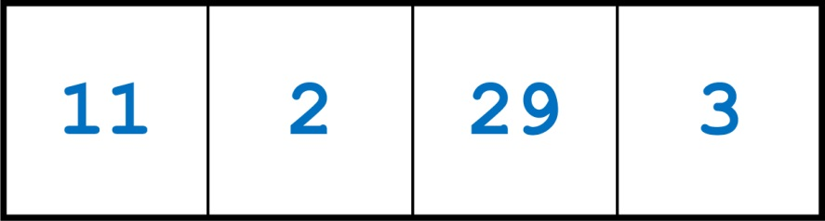
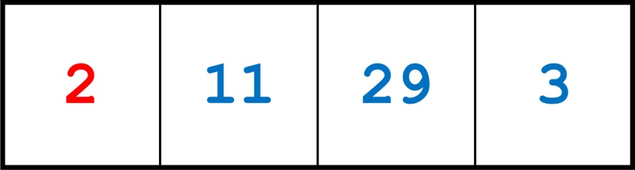
Selection Sort Example 1 of 2
Array numlist contains
The smallest element is 2. Exchange 2 with the element at subscript 0. The element in position 0 is now in order

Slide 20
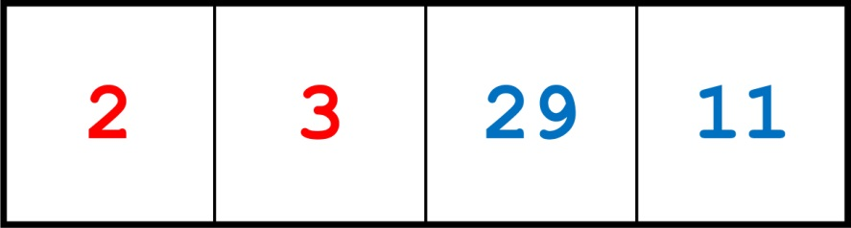
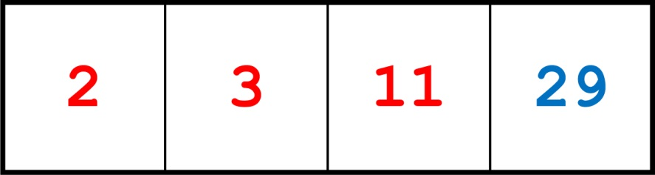
Selection Sort Example 2 of 2
The next smallest element is 3. Exchange 3 with the element at subscript 1. The element in position 1 is now in order.
The next smallest element is 11. Exchange 11 with the element at subscript 2.

Slide 21
Sorting Considerations
Although it does not have Bubble Sort’s ability to terminate the sort when it detects that all elements are in order, Selection Sort is considered more efficient than Bubble Sort.
This is due to the fewer number of exchanges that occur in Selection Sort.

Slide 22
9.4 Sorting an Array of Objects
As with searching, arrays to be sorted can contain objects or structures
The key field determines how the structures or objects will be ordered
When exchanging the contents of array elements, entire structures or objects must be exchanged, not just the key fields in the structures or objects
Notes:
See pr9-06.cpp

Slide 23
8.12 Introduction to the STL Vector
A vector holds a sequence of elements, like a one-dimensional array
Its size is flexible. It can grow and shrink
There is no need to specify the size when defined
Space is automatically added as needed
Defined in the Standard Template Library (STL)
See Chapter 17
Must include vector header file to use vectors
#include <vector>

Slide 24
Vectors
It can hold values of any data type, specified when the vector is defined
vector<int> scores;
vector<double> volumes;
You can specify initial size if desired
vector<int> scores(24);
You can use [] to access individual elements

Slide 25
Defining Vectors
Define a vector of integers (starts with 0 elements)
vector<int> scores;
Define int vector with initial size 30 elements
vector<int> scores(30);
Define 20-element int vector and initialize all elements to 0
vector<int> scores(20, 0);
Define int vector initialized to size and contents of vector finals
vector<int> scores(finals);
Notes:
See pr8-24.cpp

Slide 26
C++ 11 Features for Vectors
C++ 11 supports vector definitions that use an initialization list
vector<int> scores {88, 67, 79, 84};
Note: no = operator between the vector name and the initialization list
A range-based for loop can be used to access the elements of a vector
for (int test : scores)
cout << test << " ";
Notes:
See pr8-25.cpp

Slide 27
Growing a Vector’s Size
Use the push_back member function to add an element to a full vector or to a vector that had no defined size
// Add a new element holding the value 75
scores.push_back(75);
Use the size member function to determine the number of elements currently in a vector
int howbig = scores.size();
Notes:
See pr8-26.cpp and pr8-27.cpp

Slide 28
Removing Vector Elements
Use the pop_back member function to remove the last element from a vector
scores.pop_back();
Note: pop_back removes the last element but does not return it
To remove all of the elements from a vector, use the clear member function
scores.clear();
To determine if a vector is empty, use empty member function
while (!scores.empty()) ...
Notes:
See pr8-28.cpp, pr8-29.cpp, and pr8-30.cpp

Slide 29
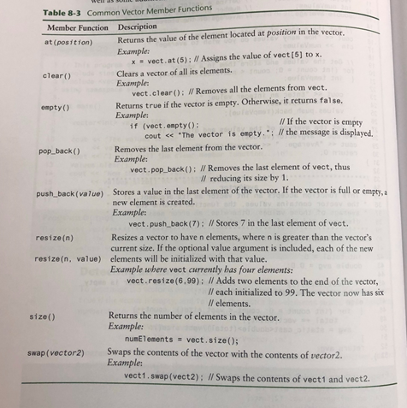

Slide 30
9.5 Sorting and Searching Vectors
Sorting and searching algorithms can be applied to vectors as well as to arrays
You need slight modifications to the sorting functions to use vector arguments
vector <type> & used in prototype
There is no need to indicate the vector size, as functions can use the vector’s size member function
Notes:
See pr9-07.cpp

Slide 31
9.6 Introduction to Analysis of Algorithms
Given two algorithms to solve a problem, what makes one better than the other?
Efficiency of an algorithm is measured by
space (computer memory used)
time (how long to execute the algorithm)
Analysis of algorithms is a more effective way to find efficiency than by using empirical data

Slide 32
Analysis of Algorithms: Terminology 1 of 3
An algorithm is a sequence of computational steps that transform the input into the output.
An algorithm is also a tool for solving a well-specified computational problem.
Computational Problem: a problem solved by an algorithm
Instance of the Problem: a specific problem that is solved by the algorithm
Size of an Instance: the amount of memory needed to hold the data for the specific problem

Slide 33
Analysis of Algorithms: Terminology 2 of 3
Basic step: an operation in the algorithm that executes in a constant amount of time
Examples of basic steps:
exchange the contents of two variables
compare two values
Non-example of a basic step:
find the largest element in an array

Slide 34
Analysis of Algorithms: Terminology 3 of 3
Complexity of an algorithm: the number of basic steps required to execute the algorithm for an input of size N (N = number of input values)
Worst-case complexity of an algorithm: the number of basic steps for input of size N that requires the most work
Average case complexity function: the complexity for typical, average inputs of size N

Slide 35
Complexity Example
Find the largest value in array A of size n
biggest = A[0]
indx = 0
while (indx < n) do
if (A[n] > biggest)
then
biggest = A[n]
end if
end while
Analysis:
Lines 1 and 2 execute once.
The test in line 3 executes n times.
The test in line 4 executes n times.
The assignment in line 6 executes at most n times.
Due to lines 3 and 4, the algorithm requires execution time proportional to n.

Slide 36
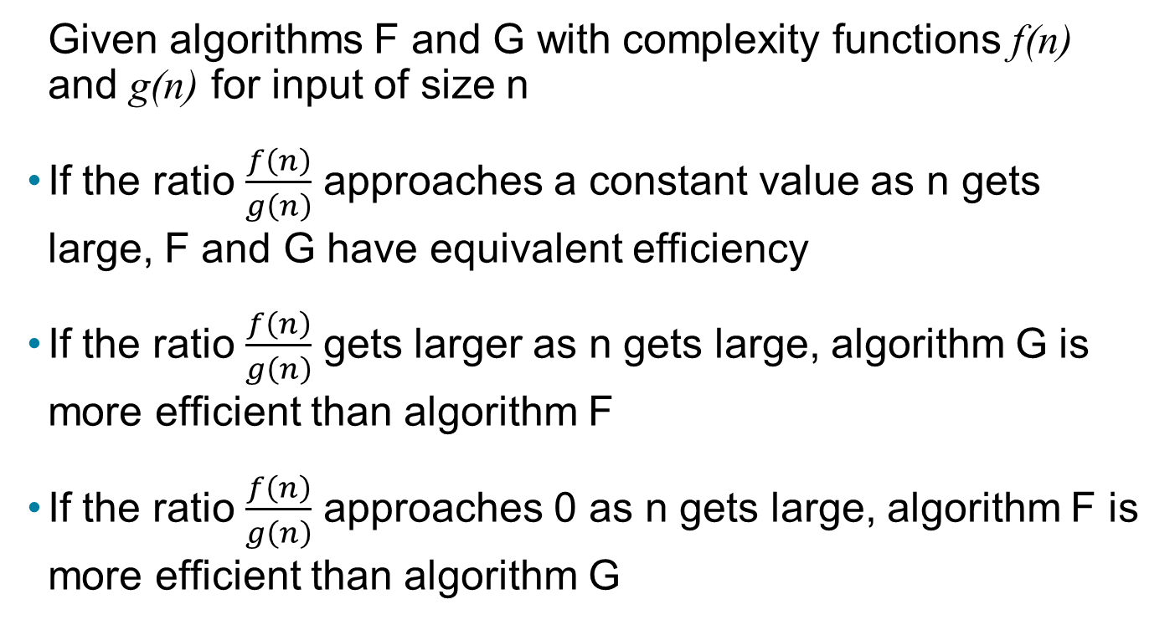
Comparison of Algorithmic Complexity
Given algorithms F and G with complexity functions f(n) and g(n) for input of size n
If the ratio $\frac{f\left(n\right)}{g\left(n\right)}$ approaches a constant value as n gets large, F and G have equivalent efficiency
If the ratio $\frac{f\left(n\right)}{g\left(n\right)}$ gets larger as n gets large, algorithm G is more efficient than algorithm F
If the ratio $\frac{f\left(n\right)}{g\left(n\right)}$ approaches 0 as n gets large, algorithm F is more efficient than algorithm G

Slide 37
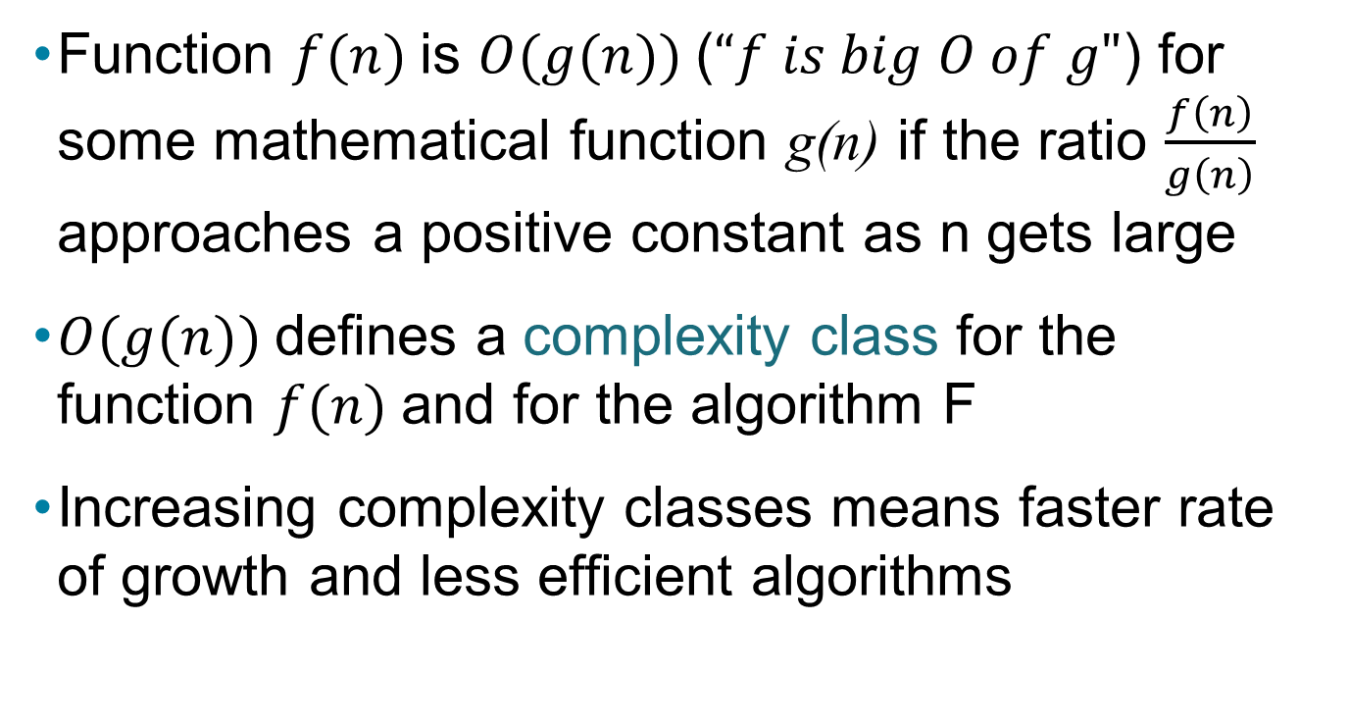
"Big O" Notation
Function $f(n)$is $O(g(n))$(“$f is big O of g"$) for some mathematical function g(n) if the ratio $\frac{f\left(n\right)}{g\left(n\right)}$ approaches a positive constant as n gets large
$O(g(n))$defines a complexity class for the function $f(n)$and for the algorithm F
Increasing complexity classes means faster rate of growth and less efficient algorithms

Slide 38

Copyright

